Slide 1
Data Visualisation for DARE data
Team 4

Slide 2
Our vision
Provide immediate benefit to users logging their data
Positive focus
Enable users to reflect and grow
Animation over time

Slide 3
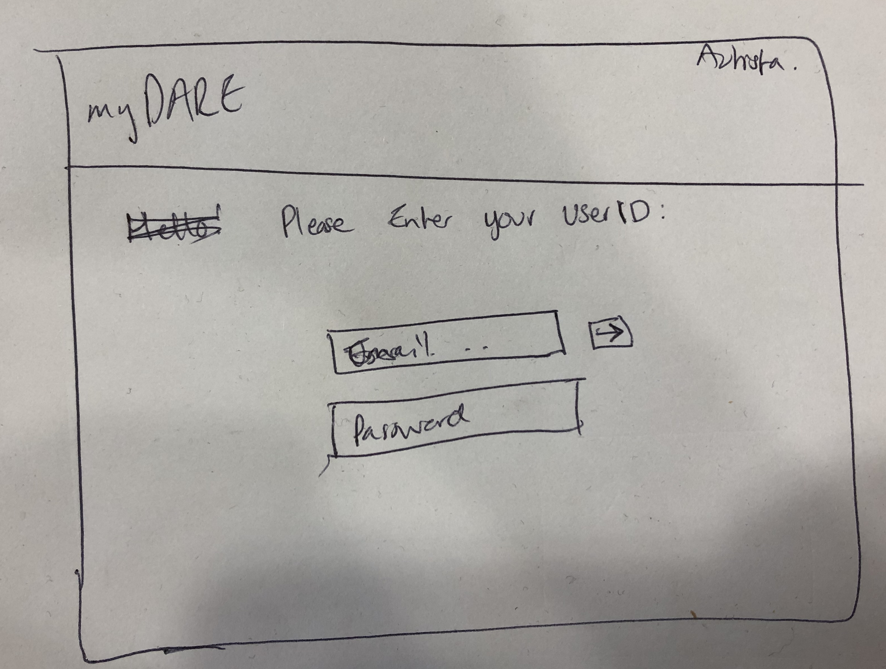
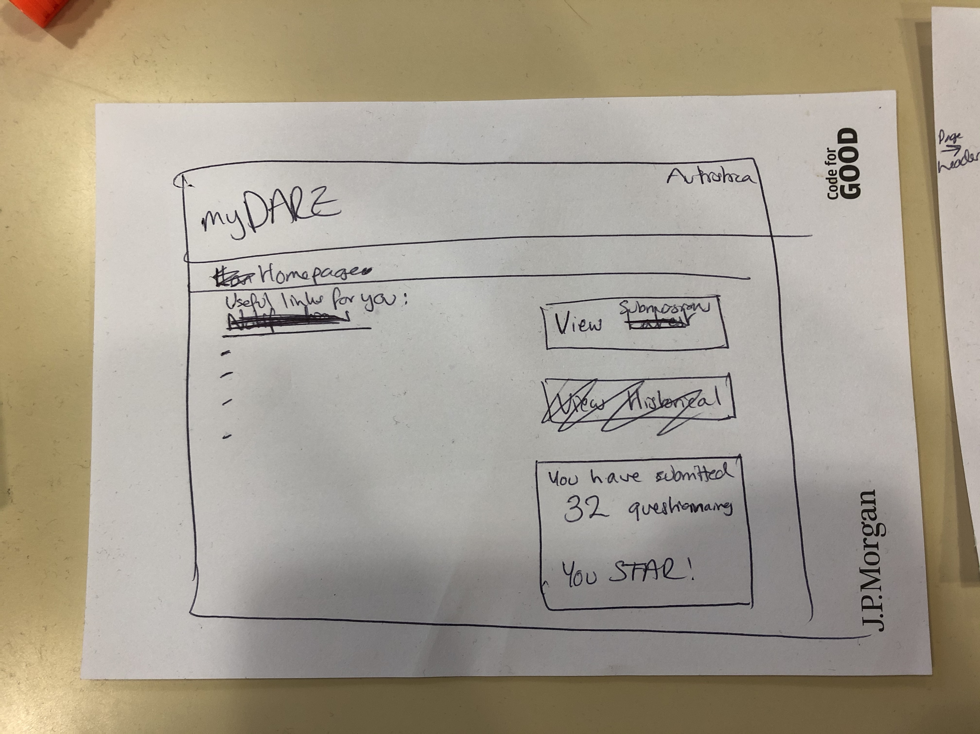
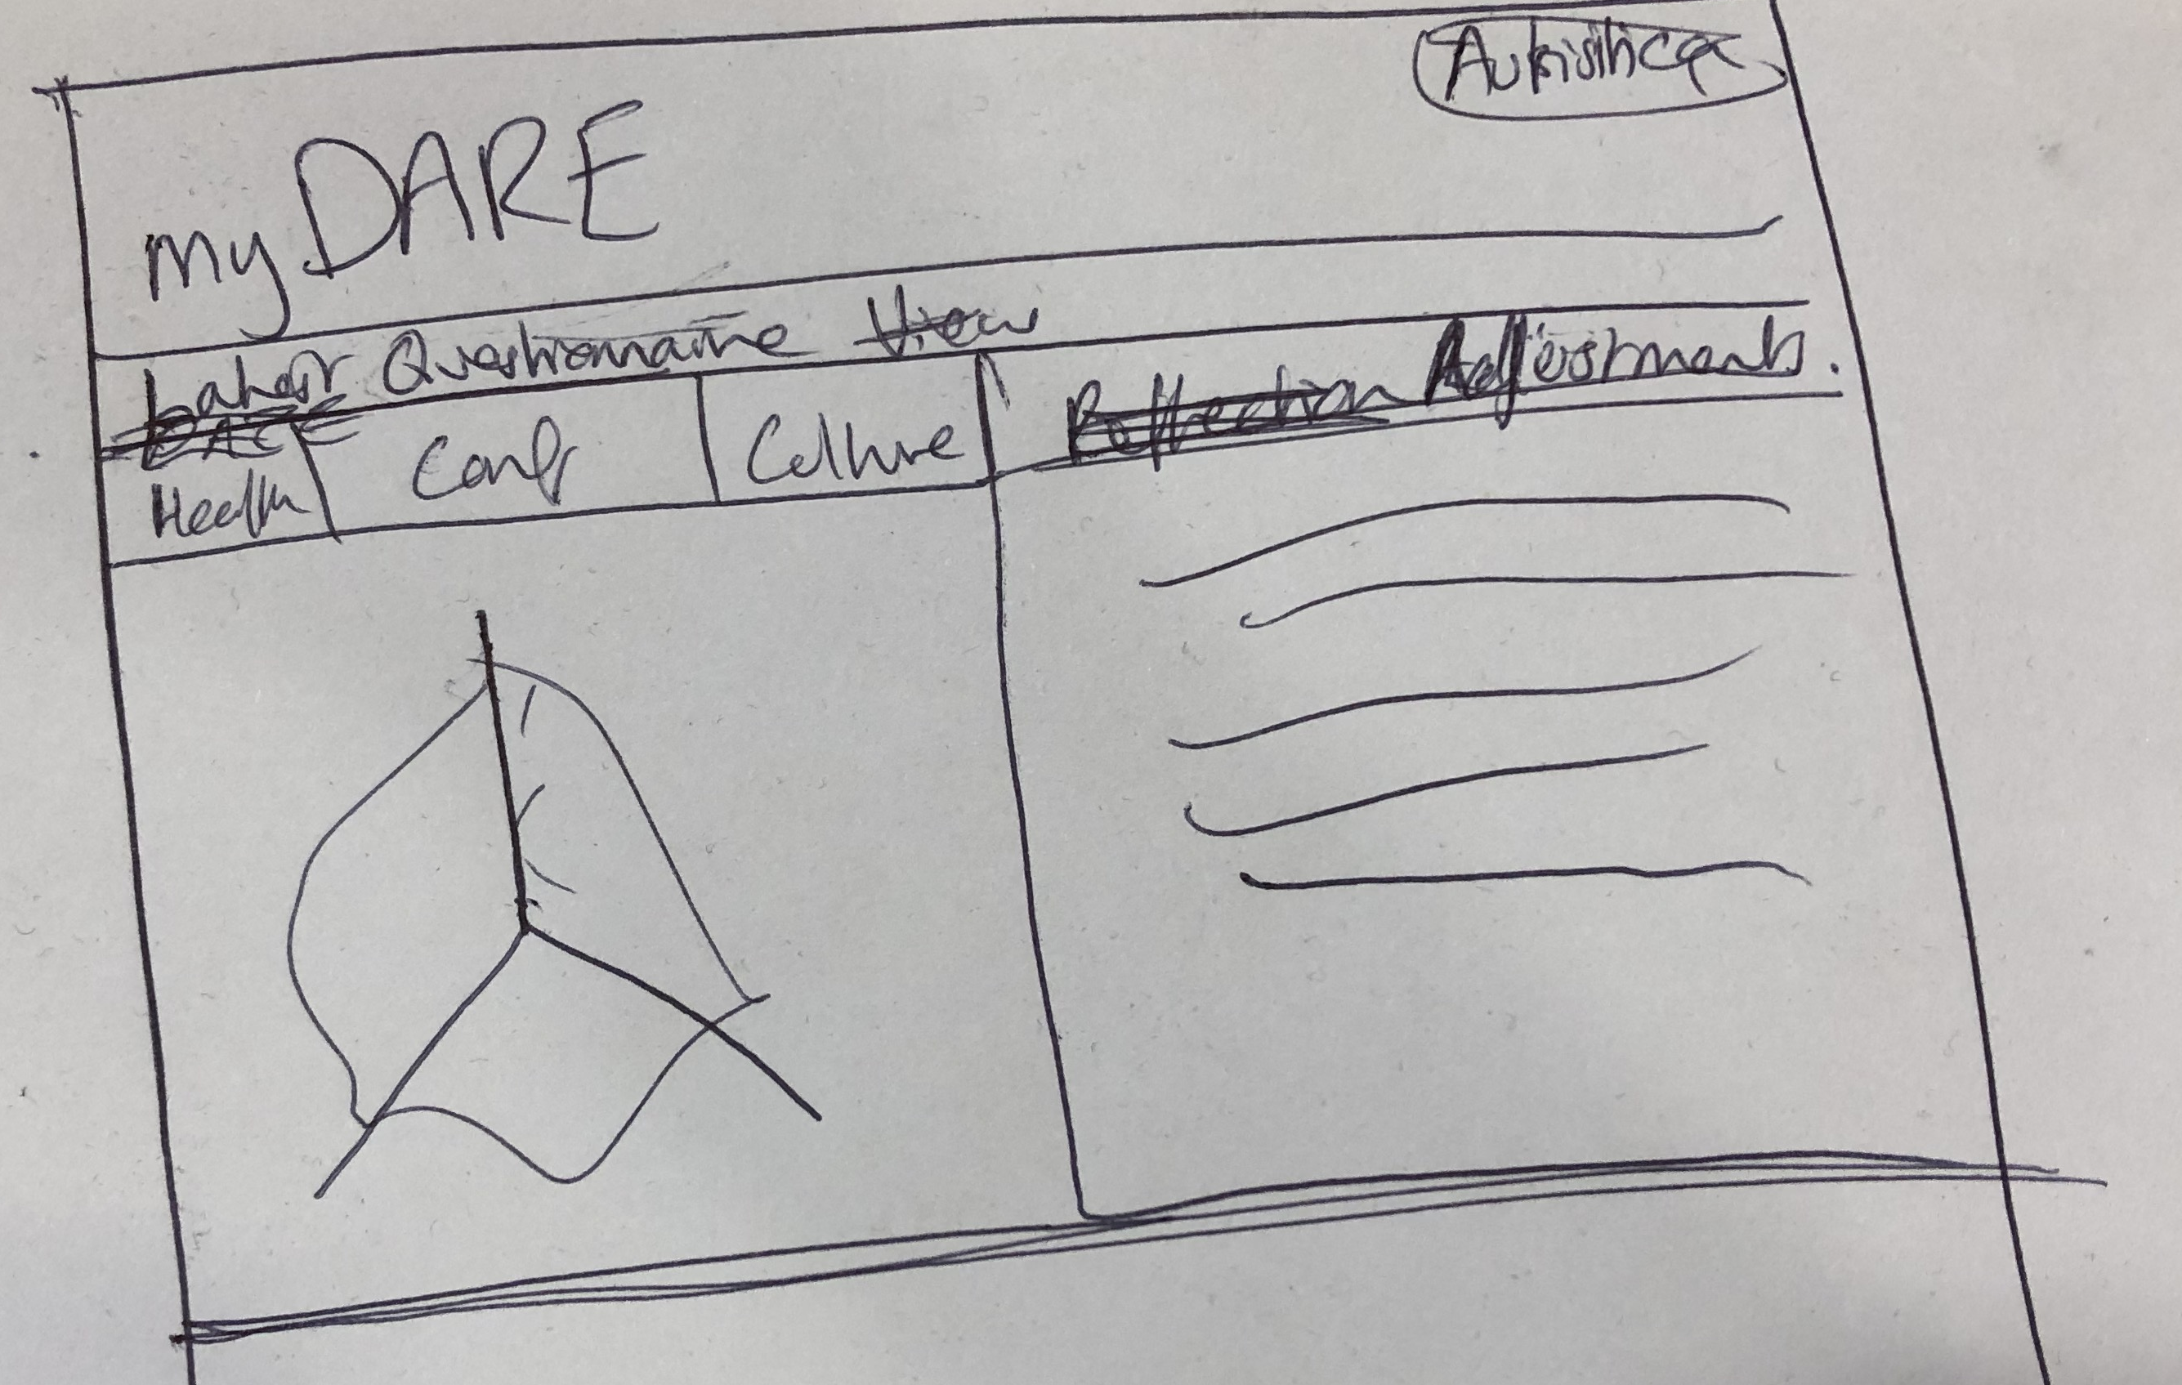

Slide 4
How we did it
Reading data from CSV files
Calculating scores from data
Verifying logins
Displaying data on webpages

Slide 5
Future development
More graphs available
Add customization
Dark/Light themes
Font sizes
More advanced advice/help features

Slide 6
Demo

